Slide 1
Building rich data-driven applications with ASP.NET Dynamic Data
Oleksandr Krakovetskyi
Software Engineer at The Frayman Group
MCP, Microsoft Regional Director
IT Jam 2010, Kharkiv

Slide 2
Agenda
What is ASP.NET Dynamic Data?
Dynamic Data project structure
Your first “Hello, IT Jam!” application
Project customization
Real-life projects
References

Slide 3
What is ASP.NET Dynamic Data
ASP.NET Dynamic Data provides a framework that enables you to quickly build a functional data-driven application, based on a LINQ to SQL or Entity Framework data model. It also adds great flexibility and functionality to the DetailsView, FormView, GridView, and ListView controls in the form of smart validation and the ability to easily change the display of these controls using templates.
Dynamic Data is part of the .NET Framework version 3.5 SP1 release.

Slide 4
Dynamic Data project structure
File or folder | Description
Content | By default, contains the Images folder and a user control (GridViewPager.ascx). The Images folder contains graphics files that are used as icons for the pager control.
CustomPages | Container folder for custom page templates. Custom page templates are used to override the page templates that are defined in DynamicData\PageTemplates.
PageTemplates | Contains for page templates that create the UI to view and edit data.
EntityTemplates | Contains entity templates that create table UI to view and edit data.
FieldTemplates | Contains user controls that create the UI to view and edit data fields.
FilterTemplates | Contains user controls that create the UI to filter data rows.

Slide 5
“Hello, IT Jam!”
Add LINQ 2 SQL (or LINQ 2 Entities) file
Create data context
In Global.asax register your data context:
DefaultModel.RegisterContext(typeof(YourContext), new ContextConfiguration() { ScaffoldAllTables = true });

Slide 6
“Hello, IT Jam!” 2
Select preferable route model, by default:
routes.Add(new DynamicDataRoute("{table}/{action}.aspx") {
Constraints = new RouteValueDictionary(new { action = "List|Details|Edit|Insert" }),
Model = DefaultModel
});
Yep, you’ve done!

Slide 7
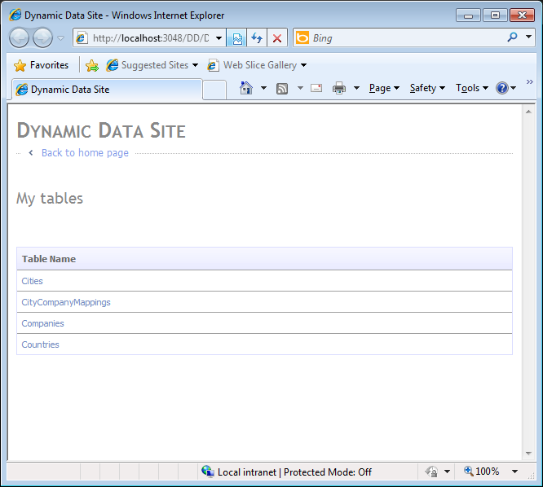
“Hello, IT Jam!” 3

Slide 8
Project Customization
Master pages
Page templates / Custom pages
Field templates
Using own components
Custom logic

Slide 9
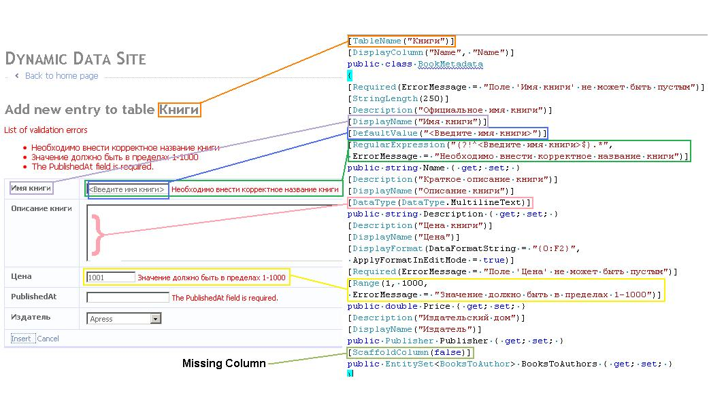
Project Customization

Slide 10
Real-life projects
“InnoVinn” company corporate website (http://innovinn.com/)
Microsoft Regional Directors Map (http://msug.vn.ua/RegionalDirectors/, Microsoft Regional Directors Bing Maps App)
Чемпионат мира по футболу 2010 в ЮАР (http://msug.vn.ua/worldcup/)

Slide 11
References
Microsoft ASP.NET Dynamic Data http://www.asp.net/dynamicdata
ASP.NET Dynamic Data Articles http://msug.vn.ua/blogs/akrakovetsky/archive/tags/asp.net+dynamic+data/default.aspx
Introduction to ASP.Net Dynamic Data Websites http://www.codedigest.com/Articles/ASPNET/292_Introduction_to_ASPNet_Dynamic_Data_Website.aspx
ASP.NET Dynamic Data – что может быть проще? http://www.developers.org.ua/archives/jony/2009/07/20/asp-net-dynamic-data/
ASP.NET Dynamic Data Content Map http://msdn.microsoft.com/en-us/library/cc488545.aspx
C# Bits http://csharpbits.notaclue.net/

Slide 12
Q&A
akrakovetsky@fraymangroup.com

